Slide 1
Lecture 21: Machine Translation: Features and Tuning
USC VSoE CSCI 544: Applied Natural Language Processing
Jonathan May -- 梅約納
November 10, 2017
slides from Philipp Koehn (and me)

Slide 2
Schedule
HW6 due today
HW7 out today (due 12/1)
Class next week 11/15 and 11/17 (Neural MT, maybe poetry, IR/QA [Dong guest lecture])
No class week after (11/20-11/24)
Last class week = 11/29 (social media mining), 12/1 (review session)
Final 12/6!

Slide 3
Itinerary
phrase extraction erratum
Log-linear models with features and weights (semi-review)
Generating candidates (n-best lists)
Optimization approaches
MERT
PRO

Slide 4
Rule Extraction: Phrase Pairs
Find contiguous blocks that respect alignment
A block can’t contain a word that is aligned outside that block
Good
Bad
(dió una bofetada, slap)
Mary
did
not
slap
the
green
witch
(no, did)
Maria no dió una bofetada a la bruja verde
Good
(Maria, Mary)
Mary
did
not
slap
the
green
witch
Good
(no, did not)
Bad
(no dió, not)
Bad
(dió una, slap)

Slide 5
Rule Extraction: Phrase Pairs
KK
Bad phrase (violation above)
Maria no dió una bofetada a la bruja verde
Mary
did
not
slap
the
green
witch
X

Slide 6
Rule Extraction: Phrase Pairs
KK
Bad phrase (violation left)
Maria no dió una bofetada a la bruja verde
Mary
did
not
slap
the
green
witch
X
X

Slide 7
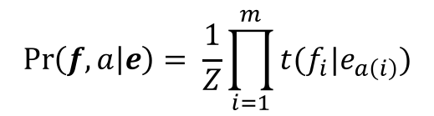
$$\operatorname{Pr}\left(f, a | e\right)= \frac{1}{Z}\prod_{i=1}^{m}{t(f_{i}|e_{a\left(i\right)})}$$

Slide 12
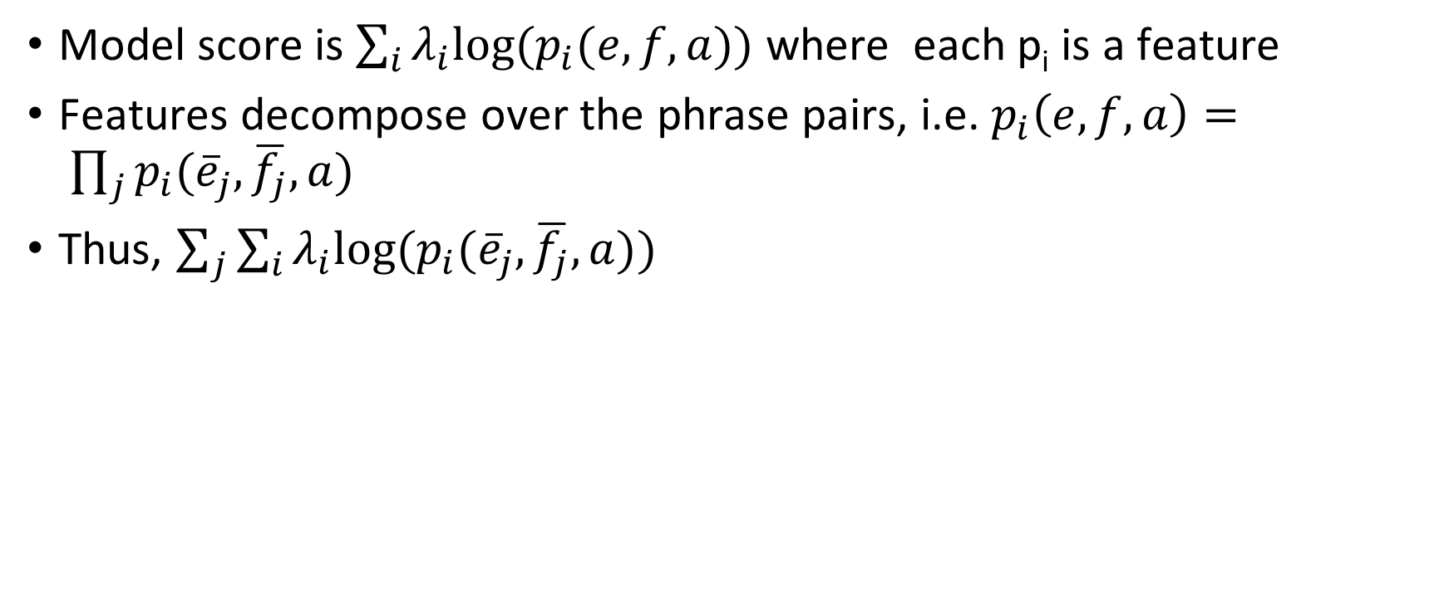
Change the Weights, change the search space
Model score is $\sum_{i}{λ_{i}{\text{log}\text{(}p}_{i}(e, f, a))}$ where each p_{i} is a feature
Features decompose over the phrase pairs, i.e. $p_{i}\left(e, f, a\right)= \prod_{j}{p_{i}({\overline{e}}_{j},\overline{f_{j}}, a)}$
Thus, $\sum_{j}{\sum_{i}{λ_{i}{\text{log}\text{(}p}_{i}({\overline{e}}_{j},\overline{f_{j}},a))}}$

Slide 13
Change The Weights, Change The Search Space
1
1
4
4
4
3
features
phrase pair | log(p1) | log(p2)
x<->a | 2 | -1
x<->b | 1 | 3
y<->c | 0 | 1
y<->d | -1 | 4
e<->z | 4 | 0
λ₁=1
λ₂=1

Slide 14
Change The Weights, Change The Search Space
-3
1
-4
-10
-4
-11
features
phrase pair | log(p1) | log(p2)
x<->a | 2 | -1
x<->b | 1 | 3
y<->c | 0 | 1
y<->d | -1 | 4
e<->z | 4 | 0
λ₁=-1
λ₂=-3

Slide 15
How To Learn The Weights?

Slide 16
Remember: Perceptron
import numpy as np
from classifier import feats, classify
w = np.zeros(|feats|)
for i in range(iterations):
for t in range(datasize):
x, y = select(X, Y)
# run current classifier
y' = classify(x, w)
if y' != y:
w += feats(x, y)-feats(x, y')
return w
doesn't make sense
for MT
C is a subroutine of L
X
Y
L
C
def classify(x, w):
scores = []
for y in labelspace:
scores.append(np.dot(w, feats(x,y)))
return argmax(scores)

Slide 17
Difference between MT and other Discriminative Models
We previously used SGD to optimize taggers and classifiers
In those cases, we considered one example at a time, knew whether it was wrong or right, and updated toward the right class, away from the wrong
MT challenges:
Can't really say whether a sentence is 'right' or 'wrong'
Can't necessarily reach the reference sentence!
But we can compare the translation we generated with other translations we could have, but didn't, generate

Slide 19

Tuning
Generate 1500-best
per input sentence
Candidate
Generation
w:
Learned
weight vector
Add to
Candidate Pool
Optimization
(Och, 2003)

Slide 23
N-Best Path Algorithm
Add an additional final state to capture the best path

Slide 24
N-Best Path Algorithm
Move labels to incoming edges
Replace edge weights with edge – state weight; showing the detour cost
Remember the -4.182 best path cost for later

Slide 25
N-Best Path Algorithm
Reverse the arrows
Label the states for our convenience

Slide 26
N-Best Path Algorithm
We will take suboptimal detours from the best path
Keep track of what detours are available

Slide 27
path number | sequence | text | additional cost
path base | base cost | detour | detour cost | total cost

Slide 28
path number | sequence | text | additional cost
1 | PNIFBA | he does not go home | 0
path base | base cost | detour | detour cost | total cost
best path found by
traversing solid arrows

Slide 29
path number | sequence | text | additional cost
1 | PNIFBA | he does not go home | 0
path base | base cost | detour | detour cost | total cost
Dashed outgoing edges after
the detour (none so far)
form new detours

Slide 30
path number | sequence | text | additional cost
1 | PNIFBA | he does not go home | 0
path base | base cost | detour | detour cost | total cost
1 | 0 | M | -.152 | -.152
1 | 0 | L | -.83 | -.83
1 | 0 | C | -1.065 | -1.065
1 | 0 | O | -1.73 | -1.73
Dashed outgoing edges after
the detour (none so far)
form new detours

Slide 31
path number | sequence | text | additional cost
1 | PNIFBA | he does not go home | 0
2 | PMIFBA | he does not go to house | -.152
path base | base cost | detour | detour cost | total cost
1 | 0 | M | -.152 | -.152
1 | 0 | L | -.83 | -.83
1 | 0 | C | -1.065 | -1.065
1 | 0 | O | -1.73 | -1.73
Top of the detour queue
forms the new path

Slide 32
path number | sequence | text | additional cost
1 | PNIFBA | he does not go home | 0
2 | PMIFBA | he does not go to house | -.152
path base | base cost | detour | detour cost | total cost
2 | -.152 | H | -.338 | -.49
1 | 0 | L | -.83 | -.83
1 | 0 | C | -1.065 | -1.065
2 | -.152 | C | -1.065 | -1.217
1 | 0 | O | -1.73 | -1.73
New detours are added
(Note: only edges after the detour
so L, O not added)

Slide 33
path number | sequence | text | additional cost
1 | PNIFBA | he does not go home | 0
2 | PMIFBA | he does not go to house | -.152
3 | PMHEBA | he goes not to house | -.49
path base | base cost | detour | detour cost | total cost
2 | -.152 | H | -.338 | -.49
3 | -.49 | G | -.043 | -.533
1 | 0 | L | -.83 | -.83
1 | 0 | C | -1.065 | -1.065
2 | -.152 | C | -1.065 | -1.217
1 | 0 | O | -1.73 | -1.73
Top of the detour path added
and new detours pushed
(only those after the detour)

Slide 34
path number | sequence | text | additional cost
1 | PNIFBA | he does not go home | 0
2 | PMIFBA | he does not go to house | -.152
3 | PMHEBA | he goes not to house | -.49
path base | base cost | detour | detour cost | total cost
3 | -.49 | G | -.043 | -.533
1 | 0 | L | -.83 | -.83
1 | 0 | C | -1.065 | -1.065
2 | -.152 | C | -1.065 | -1.217
1 | 0 | O | -1.73 | -1.73
Top of the detour path added
and new detours pushed

Slide 35
path number | sequence | text | additional cost
1 | PNIFBA | he does not go home | 0
2 | PMIFBA | he does not go to house | -.152
3 | PMHEBA | he goes not to house | -.49
4 | PMHGCA | it goes not to house | -.533
path base | base cost | detour | detour cost | total cost
3 | -.49 | G | -.043 | -.533
1 | 0 | L | -.83 | -.83
1 | 0 | C | -1.065 | -1.065
2 | -.152 | C | -1.065 | -1.217
1 | 0 | O | -1.73 | -1.73
Top of the detour path added
and new detours pushed (none)

Slide 36
path number | sequence | text | additional cost
1 | PNIFBA | he does not go home | 0
2 | PMIFBA | he does not go to house | -.152
3 | PMHEBA | he goes not to house | -.49
4 | PMHGCA | it goes not to house | -.533
5 | PLHEBA | he goes not home | -.83
path base | base cost | detour | detour cost | total cost
1 | 0 | L | -.83 | -.83
5 | -.83 | G | -.043 | -.873
1 | 0 | C | -1.065 | -1.065
2 | -.152 | C | -1.065 | -1.217
1 | 0 | O | -1.73 | -1.73
Top of the detour path added
and new detours pushed

Slide 37
path number | sequence | text | additional cost
1 | PNIFBA | he does not go home | 0
2 | PMIFBA | he does not go to house | -.152
3 | PMHEBA | he goes not to house | -.49
4 | PMHGCA | it goes not to house | -.533
5 | PLHEBA | he goes not home | -.83
6 | PLHGCA | it goes not home | -.873
path base | base cost | detour | detour cost | total cost
5 | -.83 | G | -.043 | -.873
1 | 0 | C | -1.065 | -1.065
2 | -.152 | C | -1.065 | -1.217
1 | 0 | O | -1.73 | -1.73
Top of the detour path added
and new detours pushed (none)

Slide 38
path number | sequence | text | additional cost
1 | PNIFBA | he does not go home | 0
2 | PMIFBA | he does not go to house | -.152
3 | PMHEBA | he goes not to house | -.49
4 | PMHGCA | it goes not to house | -.533
5 | PLHEBA | he goes not home | -.83
6 | PLHGCA | it goes not home | -.873
7 | PNIFCA | it does not go home | -1.065
path base | base cost | detour | detour cost | total cost
1 | 0 | C | -1.065 | -1.065
2 | -.152 | C | -1.065 | -1.217
1 | 0 | O | -1.73 | -1.73
Top of the detour path added
and new detours pushed (none)

Slide 39
path number | sequence | text | additional cost
1 | PNIFBA | he does not go home | 0
2 | PMIFBA | he does not go to house | -.152
3 | PMHEBA | he goes not to house | -.49
4 | PMHGCA | it goes not to house | -.533
5 | PLHEBA | he goes not home | -.83
6 | PLHGCA | it goes not home | -.873
7 | PNIFCA | it does not go home | -1.065
8 | PMIFCA | it does not go to house | -1.217
path base | base cost | detour | detour cost | total cost
2 | -.152 | C | -1.065 | -1.217
1 | 0 | O | -1.73 | -1.73
Top of the detour path added
and new detours pushed (none)
Note: no detour to H because
this path's detour is F->C

Slide 40
path number | sequence | text | additional cost
1 | PNIFBA | he does not go home | 0
2 | PMIFBA | he does not go to house | -.152
3 | PMHEBA | he goes not to house | -.49
4 | PMHGCA | it goes not to house | -.533
5 | PLHEBA | he goes not home | -.83
6 | PLHGCA | it goes not home | -.873
7 | PNIFCA | it does not go home | -1.065
8 | PMIFCA | it does not go to house | -1.217
9 | POKJFBA | he does not to go home | -1.73
path base | base cost | detour | detour cost | total cost
1 | 0 | O | -1.73 | -1.73
9 | -1.73 | C | 1.065 | 2.795
Top of the detour path added
and new detours pushed

Slide 41
path number | sequence | text | additional cost
1 | PNIFBA | he does not go home | 0
2 | PMIFBA | he does not go to house | -.152
3 | PMHEBA | he goes not to house | -.49
4 | PMHGCA | it goes not to house | -.533
5 | PLHEBA | he goes not home | -.83
6 | PLHGCA | it goes not home | -.873
7 | PNIFCA | it does not go home | -1.065
8 | PMIFCA | it does not go to house | -1.217
9 | POKJFBA | he does not to go home | -1.73
10 | POKJFCA | it does not to go home | -2.795
path base | base cost | detour | detour cost | total cost
9 | -1.73 | C | 1.065 | 2.795
Top of the detour path added
and new detours pushed (none)
Queue empty so we're done!

Slide 42
path number | sequence | text | additional cost | total cost (+-4.182)
1 | PNIFBA | he does not go home | 0 | -4.182
2 | PMIFBA | he does not go to house | -.152 | -4.334
3 | PMHEBA | he goes not to house | -.49 | -4.672
4 | PMHGCA | it goes not to house | -.533 | -4.715
5 | PLHEBA | he goes not home | -.83 | -5.012
6 | PLHGCA | it goes not home | -.873 | -5.055
7 | PNIFCA | it does not go home | -1.065 | -5.247
8 | PMIFCA | it does not go to house | -1.217 | -5.399
9 | POKJFBA | he does not to go home | -1.73 | -5.912
10 | POKJFCA | it does not to go home | -2.795 | -6.977

Slide 45
Quiz
You are evaluating machine translation output for adequacy and fluency.
The reference is "Mr. Johnson reported that fourth quarter losses would be greater than expected."
The MT system produced the sentence "Mr. Johnson says four quarters are greater than a dollar"
Which is a reasonable score (1-5 scale, higher = better)?
fluency = 5, adequacy = 1
adequacy = 5, fluency = 1
adequacy = 3, fluency = 2
It cannot be determined without seeing the foreign language input

Slide 46
Optimization

Slide 48
(MERT)

Slide 50
slope = a_{i}
b_{i}
if all other weights are constant

Slide 54
Calculate threshold points for all sentences in the corpus
Whenever a threshold is reached, the one-best changes for one sentence
Keep track of the change in ngram matches for that one sentence
Thus we can constantly evaluate corpus BLEU while setting λ.

Slide 55
(i.e. BLEU)

Slide 57
You can only optimize among
the translations that have been generated!

Slide 58
Tuning
Generate 1500-best
per input sentence
Better vector
makes better sentences
Candidate
Generation
w:
Pool keeps growing
Learned
weight vector
Add to
Candidate Pool
Optimization
(Och, 2003)

Slide 59
How MERT works
features
BLEU+1
The MERT algorithm works by varying one weight at a time to find a value for that weight that aligns the best model score
with the best extrinsic score
2
4
.28
3
8
.44
S1
6
1
.12
-3
-3
.15
1
5
.18
(error score)
S2
-5
-3
(BLEU+1)
.32

Slide 60
How MERT works
features
model
score
BLEU+1
The MERT algorithm works by varying one weight at a time to find a value for that weight that aligns the best model score
with the best extrinsic score
(MERT can optimize the non-decomposable BLEU; swap these for n-gram component values and determine total with the BLEU equation)
2
4
0
.28
3
8
0
.44
S1
6
1
0
.12
-3
-3
0
.15
1
5
0
.18
S2
-5
-3
0
.32
w:
0
0
total:
.43

Slide 61
How MERT works
features
model
score
BLEU+1
The MERT algorithm works by varying one weight at a time to find a value for that weight that aligns the best model score
with the best extrinsic score
(MERT can optimize the non-decomposable BLEU; swap these for n-gram component values and determine total with the BLEU equation)
2
4
0
.28
3
8
0
.44
S1
6
1
0
.12
-3
-3
0
.15
1
5
0
.18
S2
-5
-3
0
.32
w:
0
0
total:
.43
vary
hold

Slide 62
How MERT works
features
model
score
BLEU+1
The MERT algorithm works by varying one weight at a time to find a value for that weight that aligns the best model score
with the best extrinsic score
2
4
-2
.28
3
8
-3
.44
S1
6
1
-6
.12
-3
-3
3
.15
1
5
-1
.18
S2
-5
-3
5
.32
w:
-1
0
total:
.60
vary
hold

Slide 63
How MERT works
features
model
score
BLEU+1
The MERT algorithm works by varying one weight at a time to find a value for that weight that aligns the best model score
with the best extrinsic score
2
4
-2
.28
3
8
-3
.44
S1
6
1
-6
.12
-3
-3
3
.15
1
5
-1
.18
S2
-5
-3
5
.32
w:
-1
0
total:
.60
hold
vary

Slide 64
How MERT works
features
model
score
BLEU+1
The MERT algorithm works by varying one weight at a time to find a value for that weight that aligns the best model score
with the best extrinsic score
2
4
2
.28
3
8
5
.44
S1
6
1
-5
.12
-3
-3
0
.15
1
5
4
.18
S2
-5
-3
2
.32
w:
-1
1
total:
.62
hold
vary

Slide 65
How MERT works
features
model
score
BLEU+1
The MERT algorithm works by varying one weight at a time to find a value for that weight that aligns the best model score
with the best extrinsic score
2
4
0
.28
3
8
2
.44
S1
6
1
-11
.12
-3
-3
3
.15
1
5
1
.18
S2
-5
-3
7
.32
w:
-2
1
total:
.76
vary
hold

Slide 66
How MERT works
features
model
score
BLEU+1
2
4
0
2
??
.28
3
8
1
3
??
.44
S1
6
1
1
-5
??
.12
-3
-3
0
7
??
.15
1
5
0
17
??
.18
S2
-5
-3
2
6
??
.32
w:
-2
1
3
16
This works well for small feature sets, but as the feature space grows, it is hard to find a good position

Slide 67
Lots of Features can be Useful!
Lexicalized Feature templates (thousands of sparse binaries)
phrase_seen_X_times
fword_X_eword_Y
insert_eword_Y
ephrase_Y_Z
Base Features (10-12)
Language Model(s)
Reordering Model
{Direct, Inverse} {Phrase, Word} Translation Model
{Word, Phrase, Phrase Pair, Character} count
Word drop count

Slide 68
Synthetic Experiment
random
random
random
“Candidate pool” of randomly drawn “feature” vectors
(Hopkins & May, 2011)

Slide 69
Synthetic Experiment
"features"
?
random
random
random
“Candidate pool” of randomly drawn “feature” vectors
How to determine “extrinsic score”?
(Hopkins & May, 2011)

Slide 70
Synthetic Experiment
"BLEU+1"
goal weights
random
random
random
“Candidate pool” of randomly drawn “feature” vectors
Secret “goal weights” used to calculate extrinsic score
(Hopkins & May, 2011)

Slide 71
Synthetic Experiment
SECRET
goal weights
learned weights
random
random
random
MERT algorithm
Now use MERT to try and learn the goal weights back
This is linear equation solving
It’s much easier than MT tuning

Slide 72
Synthetic Experiment
≈?
goal weights
learned weights
random
random
random
MERT algorithm
Now use MERT to try and learn the goal weights back
This is linear equation solving
It’s much easier than MT tuning
SECRET

Slide 73
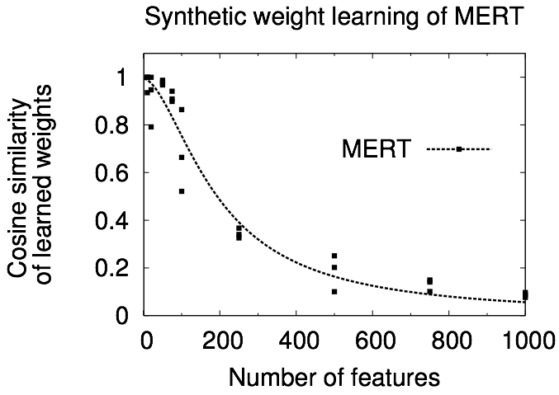
MERT doesn’t scale

Slide 74
MERT only cares about the
top-scoring translation
features
model
score
2
4
0
2
translation ranks
(lower is better)
3
8
2
1
S1
6
1
-11
3
-3
-3
3
3
1
5
1
2
S2
-5
-3
7
1

Slide 75
MERT only cares about the
top-scoring translation
features
model
score
2
4
??
2
MERT doesn’t care about these
3
8
1
1
S1
6
1
??
3
-3
-3
??
3
1
5
??
2
S2
-5
-3
1
1
model score ranks

Slide 76
It doesn’t care about matching the overall ranking
2
4
2
2
3
8
1
1
S1
6
1
3
3
-3
-3
2
3
mismatch!
1
5
3
2
S2
-5
-3
1
1

Slide 77
This could lead to poor generalization
2
4
0
2
4
3
8
2
1
1
6
1
3
3
7
-4
9
19
not good but
liked by model
12
-2
2
7
...
...
...
...
good but
disliked
S1
-12
5
66
4
-3
-3
2
3
1
5
3
2
S2
-5
-3
1
1

Slide 78
We should focus on rank
this one is better
1
1
1
1
2
2
5
2
3
3
4
3
4
4
3
4
5
5
2
5
Recognize that these are different solutions!
(To MERT they are the same)

Slide 79
We can describe rank from a pairwise perspective
translation a
translation b
fa
ha
ga
fb
hb
gb
For any two translations a and b of the same sentence
(Herbrich et al., ’99)

Slide 80
We can describe rank from a pairwise perspective
translation a
translation b
fa
ha
ga
fb
hb
gb
ga
>
gb
ha
>
hb
Model and extrinsic
score order should agree

Slide 81
We can describe rank from a pairwise perspective
translation a
translation b
fa
ha
ga
fb
hb
gb
ga
>
gb
ha
>
hb
ha
-
hb
> 0

Slide 82
We can describe rank from a pairwise perspective
translation a
translation b
fa
ha
ga
fb
hb
gb
ga
>
gb
ha
>
hb
-
ha
hb
> 0
-
w
fa
w
fb
> 0

Slide 83
We can describe rank from a pairwise perspective
translation a
translation b
fa
ha
ga
fb
hb
gb
ga
>
gb
ha
>
hb
-
ha
hb
> 0
-
w
fa
w
fb
> 0
w
fa-fb
> 0

Slide 84
This is a binary
classification problem
ga
>
gb
w
fa-fb
> 0

Slide 85
This is a binary
classification problem
ga
>
gb
w
fa-fb
> 0
label
(+ if a is better,
- if b is better)
training instance
(difference vector)
+
fa-fb

Slide 86
Find the separating vector
+
-
+
-
+
-
+
-
+
-
+
-
Δf1
+
-
-
+
-
+
-
+
+
-
Δf2

Slide 87
Find the separating vector
+
-
+
-
+
-
+
-
+
-
+
-
Δf1
+
+
-
-
+
-
+
-
+
-
w
fa-fb
= 0
Δf2

Slide 88
Find the separating vector
+
-
+
-
+
-
+
-
+
-
+
-
w
fa-fb
> 0
Δf1
+
+
-
-
+
-
+
-
+
-
w
fa-fb
< 0
w
fa-fb
= 0
We can find this with logistic regression!
Δf2

Slide 89
Avoid Intractability
Sample from the pool to avoid blowup (Dreyer/Dong '15 extension avoids this)
Focus on difference vectors with large differences
Add evil twins to ensure balance
-
+
+
-
-
+
+
-
fa-fb
fb-fa
(Nimoy, ’68)

Slide 90
MERT Tuning
Generate 1500-best
per input sentence
Candidate
Generation
w:
MERT framework
Learned
weight vector
Add to
Candidate Pool
MERT
Optimization
(Och, 2003)

Slide 91
PRO Tuning
Generate 1500-best
per input sentence
Candidate
Generation
w:
MERT framework
Learned
weight vector
Add to
Candidate Pool
MegaM
Sample pairs
Pairwise Ranking
Optimization
(Och, 2003)
MERT
Optimization

Slide 92
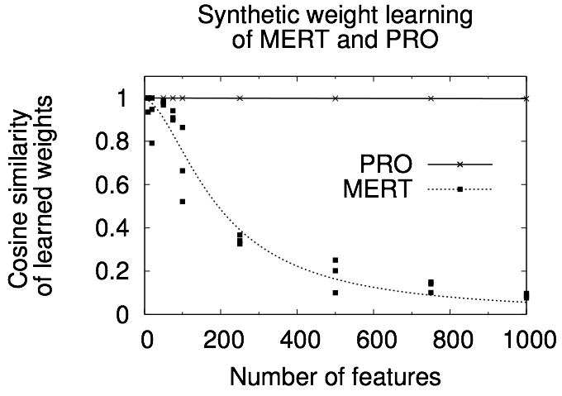
PRO scales
random
random
random
random
random
random
random
random
random
random
random
random
Unlike MERT, PRO is unfazed by
a large number of features in the synthetic test

Slide 93
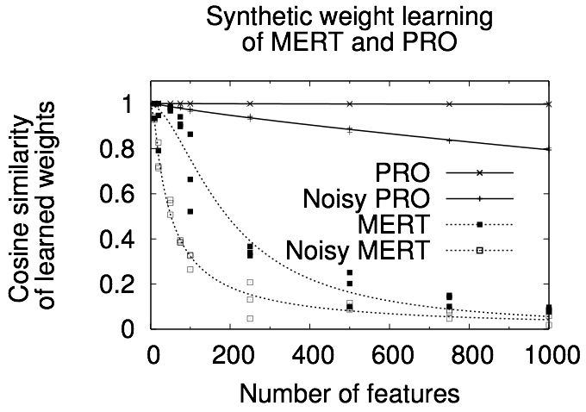
PRO scales
random
random
random
random
random
random
random
random
random
random
random
random
Adding noise to the synthetic test makes it more difficult
but PRO still does quite well compared to MERT

Slide 94
Experimental Setup
Language | Data (words) |  |  | Features
 | Train | Tune | Test | PBMT |  |  | SBMT
 |  |  |  | base |  | ext | base | ext
Urdu-English | 2.2M (NIST 2009) | 16K (NIST 2008) | 18K (NIST 2008) | 15 | 2250 |  | 19 | 277
Arabic-English | 175M (NIST 2008) | 65K (NIST 03-06/GALE) | 47K (NIST 2008) | 15 | 6333 |  | 19 | 352
Chinese-English | 173M (GALE 2008) | 42K (NIST 03-06) | 37K (NIST 2008) | 15 | 1828 |  | 19 | 517

Slide 95
PRO is fast

Slide 96
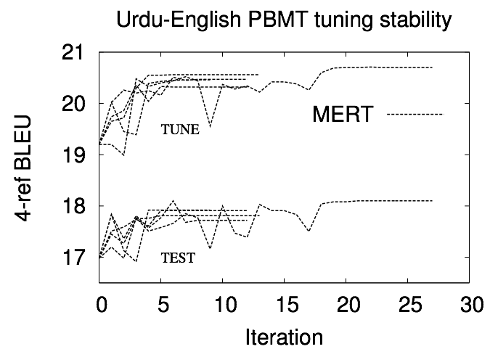
MERT is unstable
Result from five identical runs
(Clark et al., 2011)

Slide 97
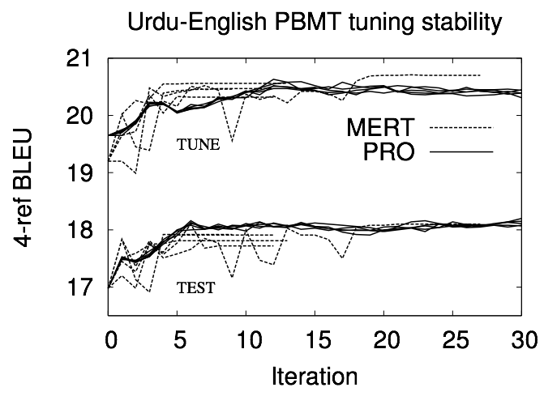
PRO is stable
Result from five identical runs

Slide 98
Pro allows more features to shine

Slide 99
Tuning Summary
Discriminative models require data-driven weight setting
Complicated output and scoring metrics require boutique solutions
Algorithms
Efficiently calculating n-best from decoding graph
MERT: calculate envelope where BLEU changes and optimize one direction at a time
PRO: treat ranked pair ordering as a classification problem

